Slide 1
DDR Rowhammer Project
Rami Arafeh, Tyler Ricks
Prof. Mike Wirthlin

Slide 2
Outline
Goals of the Project
DRAM
Rowhammer Attacks
Progress
Ethical Question

Slide 3
Goals of the project
Develop and verify DDR controllers for FPGAs that provide both reliability and security
Understand and quantify how the data in the DDR itself fails rather how the FPGA controller fails

Slide 4
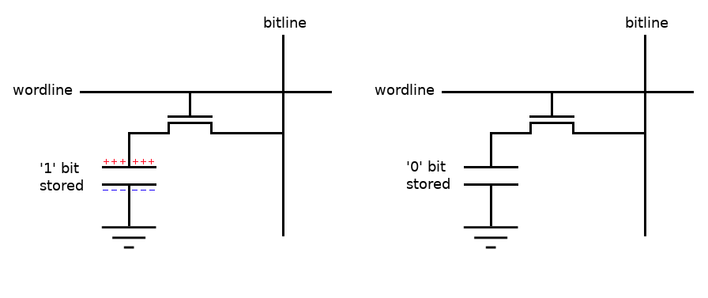
DRAM
Each bit is stored in a cell using a capacitor
Lose state over time -> Dynamic
Data stored refreshed at regular interval
https://www.electronics-notes.com/articles/electronic_components/semiconductor-ic-memory/dynamic-ram-how-does-dram-work-operation.php

Slide 5
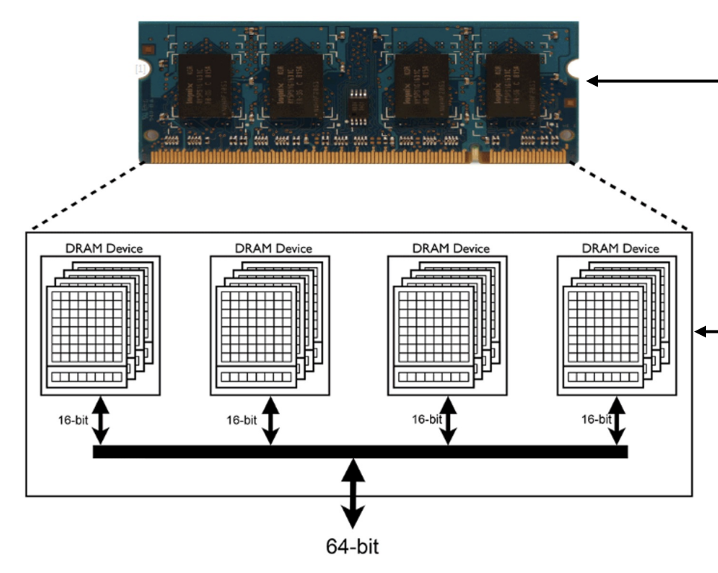
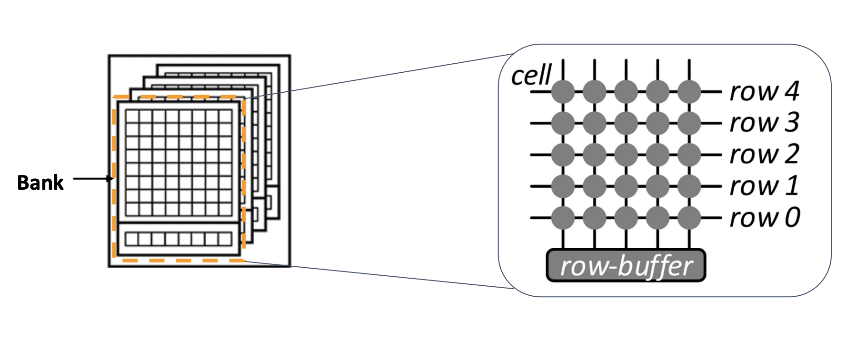
DRAM Organization
https://apt.cs.manchester.ac.uk/projects/ARMOR/RowHammer/index.html

Slide 6
Rowhammer Attacks
Predictably induce bit flips in DRAM chips
Row
Row
Row
Row
Row

Slide 7
Rowhammer Attacks
Predictably induce bit flips in DRAM chips
Row
Row
Row
Row
Row

Slide 8
Single-Sided Rowhammer
Row
Victim Row
Hammered Row
Victim Row
Row

Slide 9
Double-Sided Rowhammer
Row
Hammered Row
Victim Row
Hammered Row
Row

Slide 10
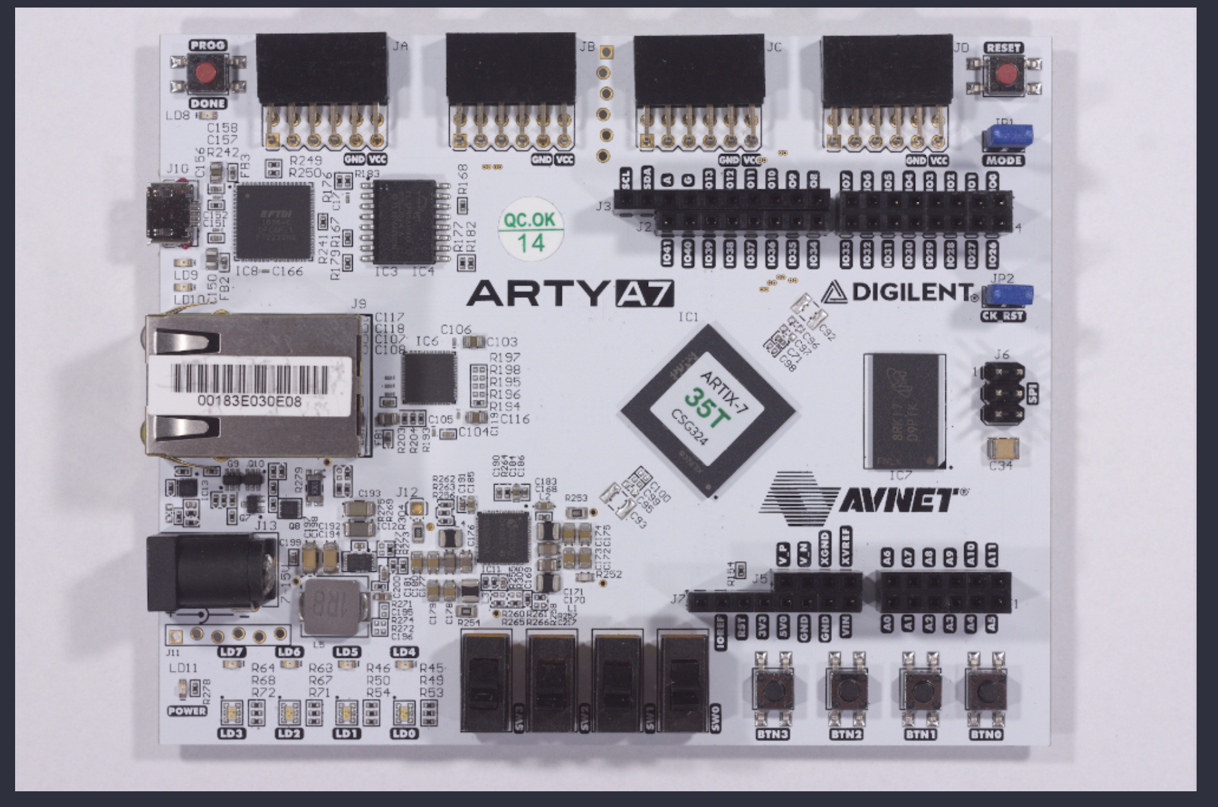
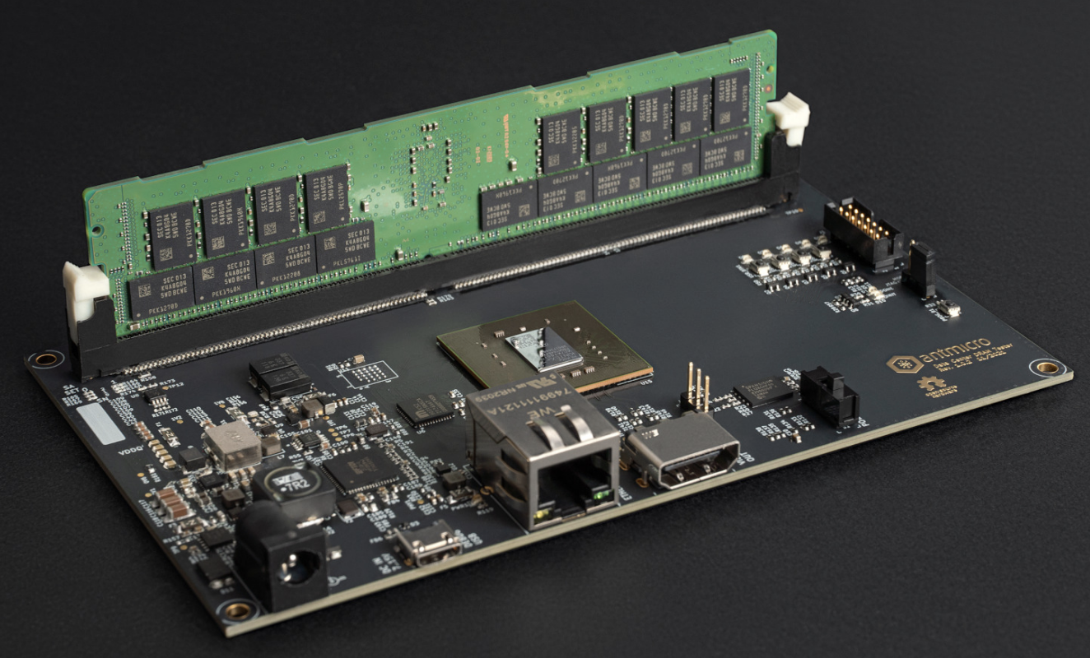
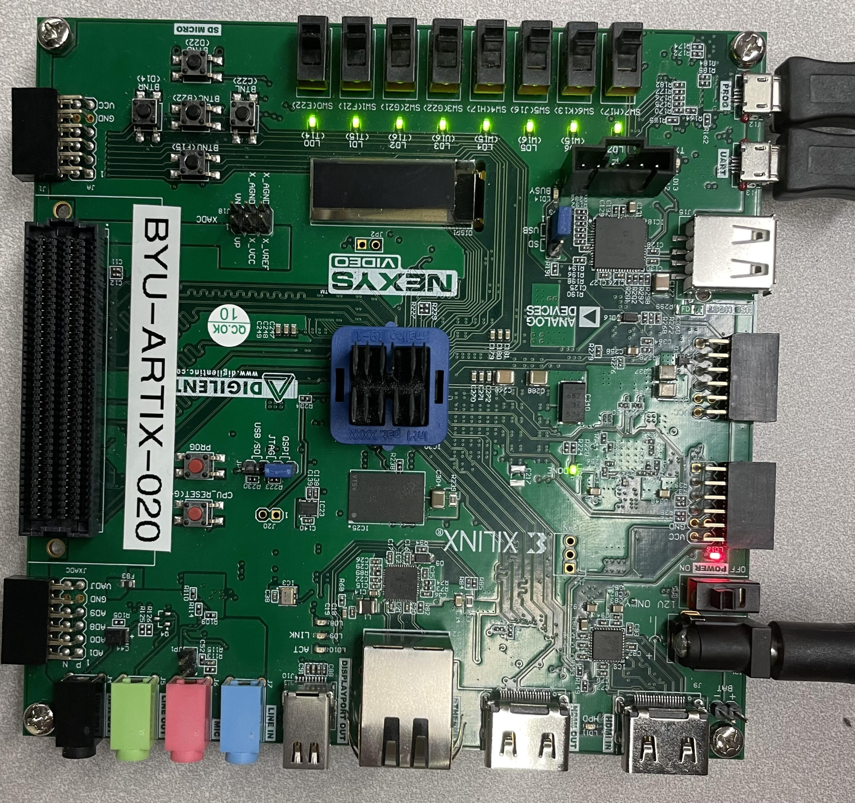
DDR3 DDR4
https://rowhammer-tester.readthedocs.io/en/latest/ddr4_datacenter_dram_tester.html

Slide 11
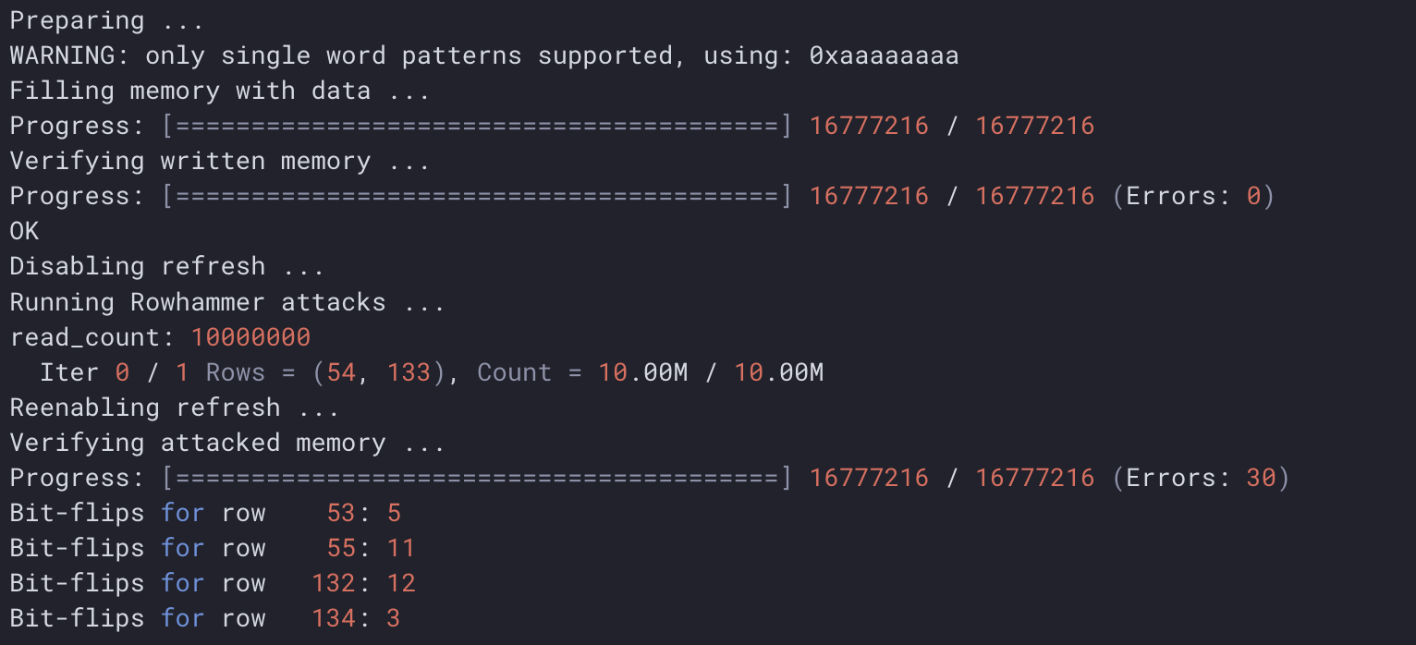
(venv) $python hw_rowhammer.py --nrows 512 --read_count 10e6 --pattern 01_in_row --row-pairs const --const-rows-pair 54 133 --no-refresh
https://rowhammer-tester.readthedocs.io/en/latest/usage.html

Slide 12
Mitigations
ECC memory
TRR
2x refresh rate

Slide 13
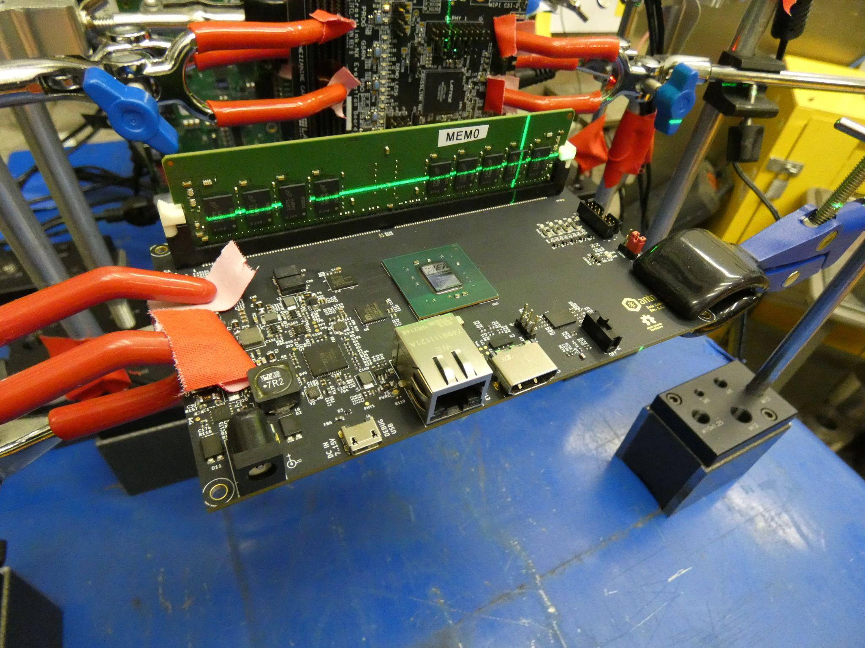
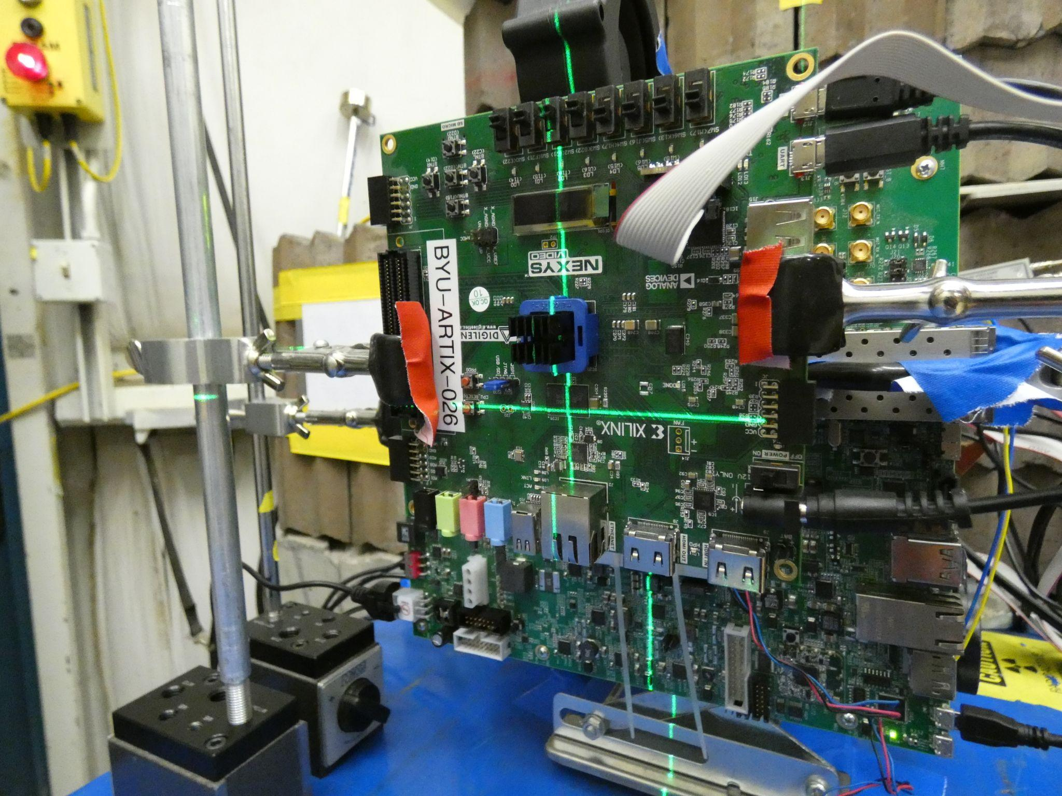

Slide 14
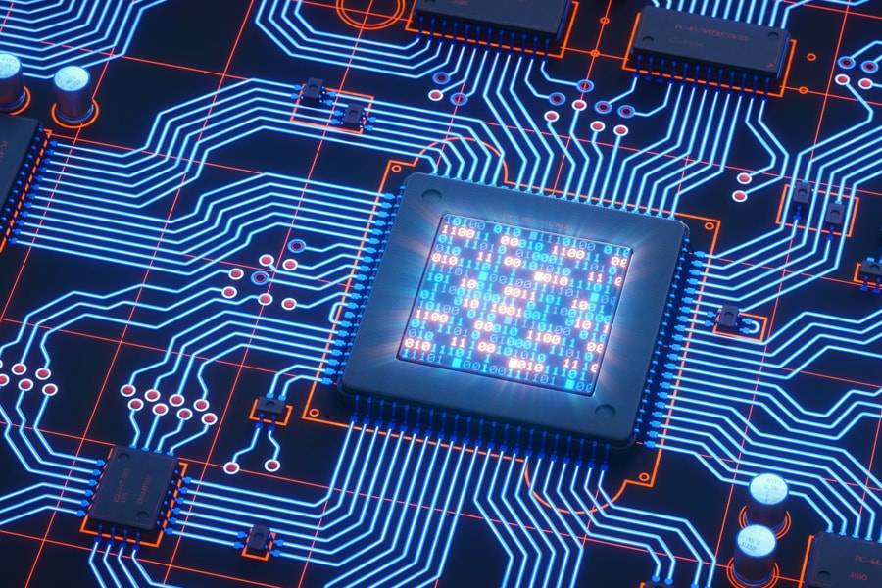
Ethical Question

Slide 15

Questions?

